Slide 1
Motion and CTF estimation
Institute of Statistical Science, Academia Sinica

Slide 2
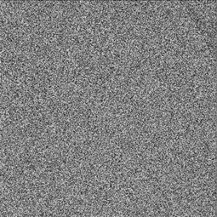
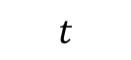
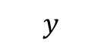
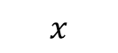
Motion Correction
Motion Correction
The invention of DDD
The movie mode allows Motion estimation to be performed
CTF Estimation
$$y$$
$$x$$
Particle Picking
$$t$$
Notes:
B factor weighting
direct electron detection device

Slide 3
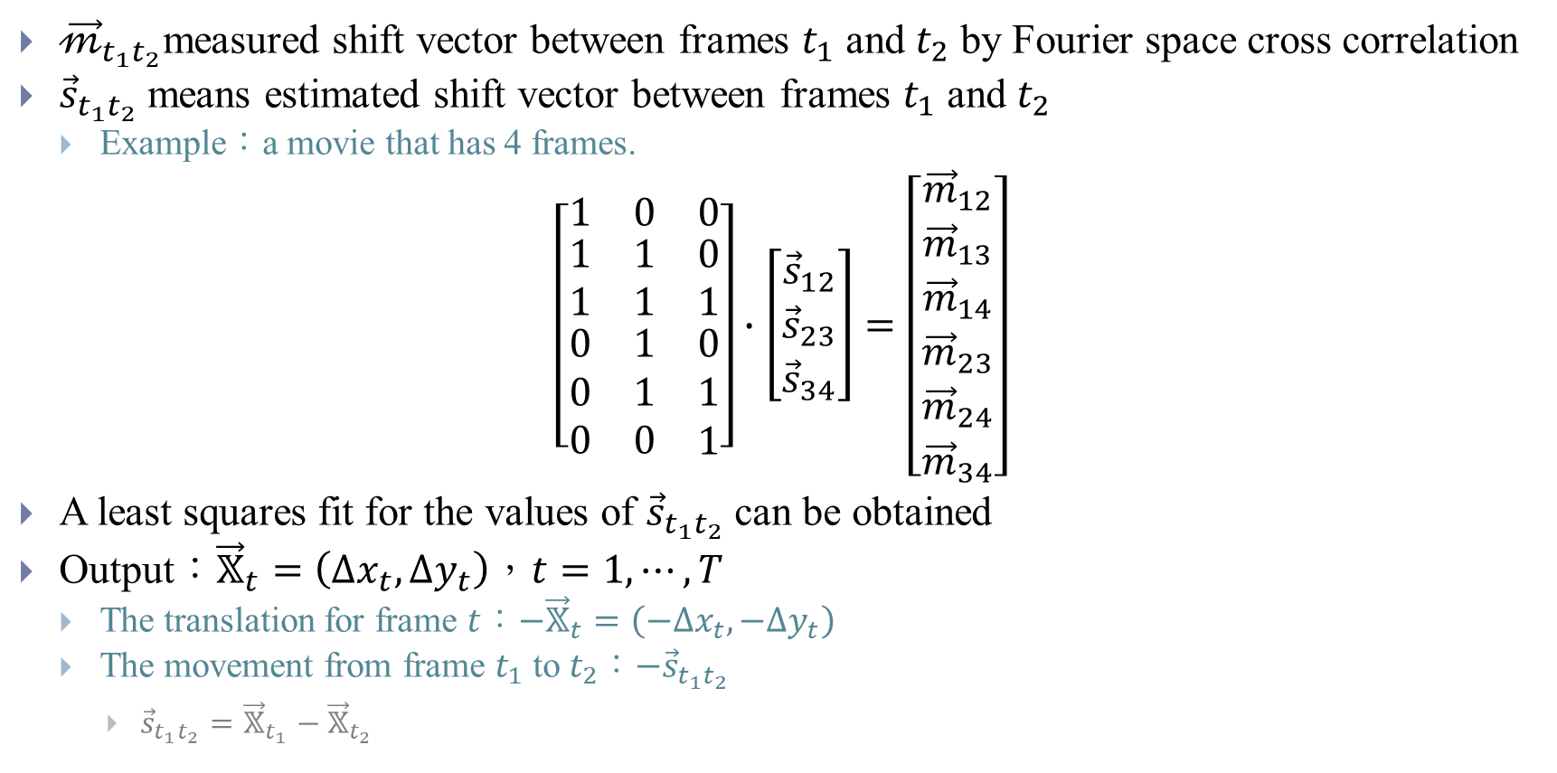
Motioncorr (2013)
${\vec{𝓂}}_{t_{1}t_{2}}$measured shift vector between frames $t_{1}$ and $t_{2}$ by Fourier space cross correlation
${\vec{s}}_{t_{1}t_{2}}$ means estimated shift vector between frames $t_{1}$ and $t_{2}$
Example：a movie that has 4 frames.
$$\left[\begin{matrix}1 & 0 & 0 \\ \begin{matrix}1 \\ 1\end{matrix} & \begin{matrix}1 \\ 1\end{matrix} & \begin{matrix}0 \\ 1\end{matrix} \\ \begin{matrix}0 \\ 0 \\ 0\end{matrix} & \begin{matrix}1 \\ 1 \\ 0\end{matrix} & \begin{matrix}0 \\ 1 \\ 1\end{matrix}\end{matrix}\right]∙\left[\begin{matrix}{\vec{s}}_{12} \\ {\vec{s}}_{23} \\ {\vec{s}}_{34}\end{matrix}\right]=\left[\begin{matrix}{\vec{m}}_{12} \\ \begin{matrix}{\vec{m}}_{13} \\ \begin{matrix}{\vec{m}}_{14} \\ {\vec{m}}_{23}\end{matrix} \\ {\vec{m}}_{24}\end{matrix} \\ {\vec{m}}_{34}\end{matrix}\right]$$
A least squares fit for the values of ${\vec{s}}_{t_{1}t_{2}}$ can be obtained
Output：${\vec{𝕏}}_{t}=\left(∆x_{t},∆y_{t}\right)$，$t=1,⋯,T$
The translation for frame $t$：$−{\vec{𝕏}}_{t}=\left(−∆x_{t},−∆y_{t}\right)$
The movement from frame $t_{1}$ to $t_{2}$：$−{\vec{s}}_{t_{1}t_{2}}$
${\vec{s}}_{t_{1}t_{2}}={\vec{𝕏}}_{t_{1}}−{\vec{𝕏}}_{t_{2}}$
Notes:
${\vec{𝓂}}_{t_{1}t_{2}}$ can be measured by locating the maximum value of the cross correlation map between the frames $t_{1}$ and $t_{2}$

Slide 4
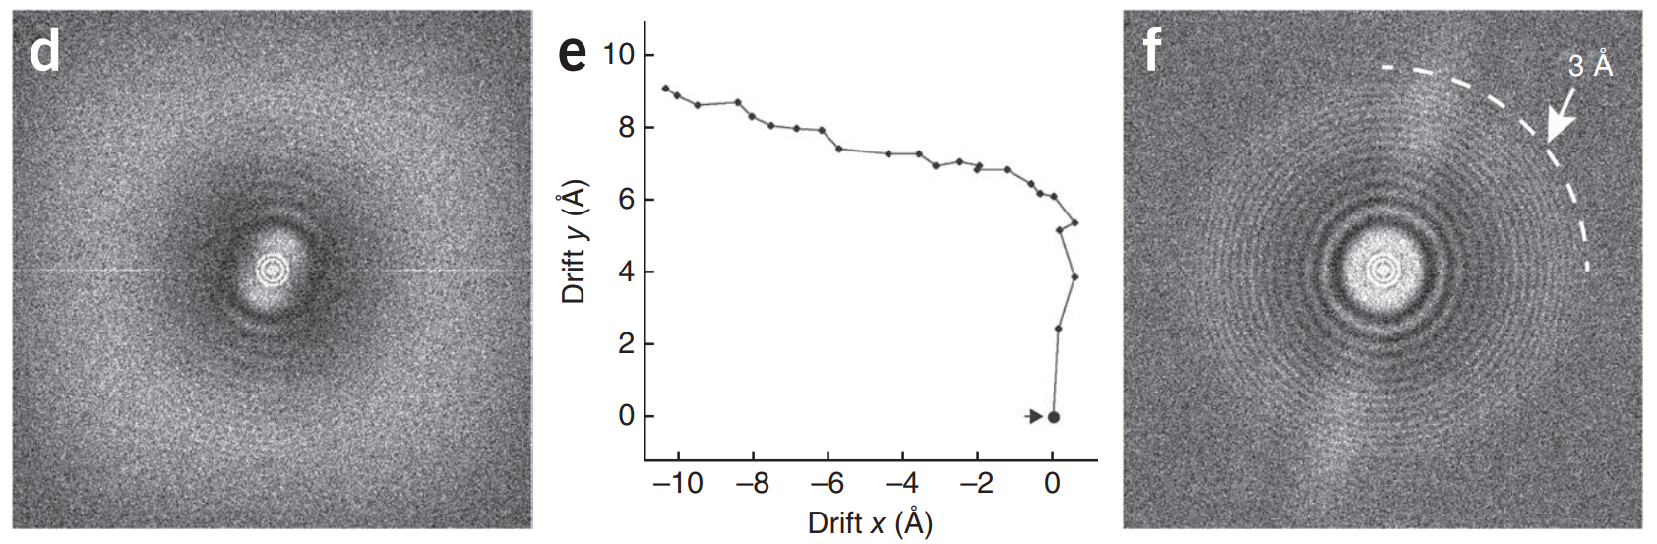
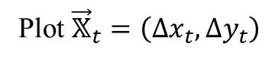
Motioncorr (2013)
Plot ${\vec{𝕏}}_{t}=\left(∆x_{t},∆y_{t}\right)$

Slide 5
Unblur (2015)

Slide 6
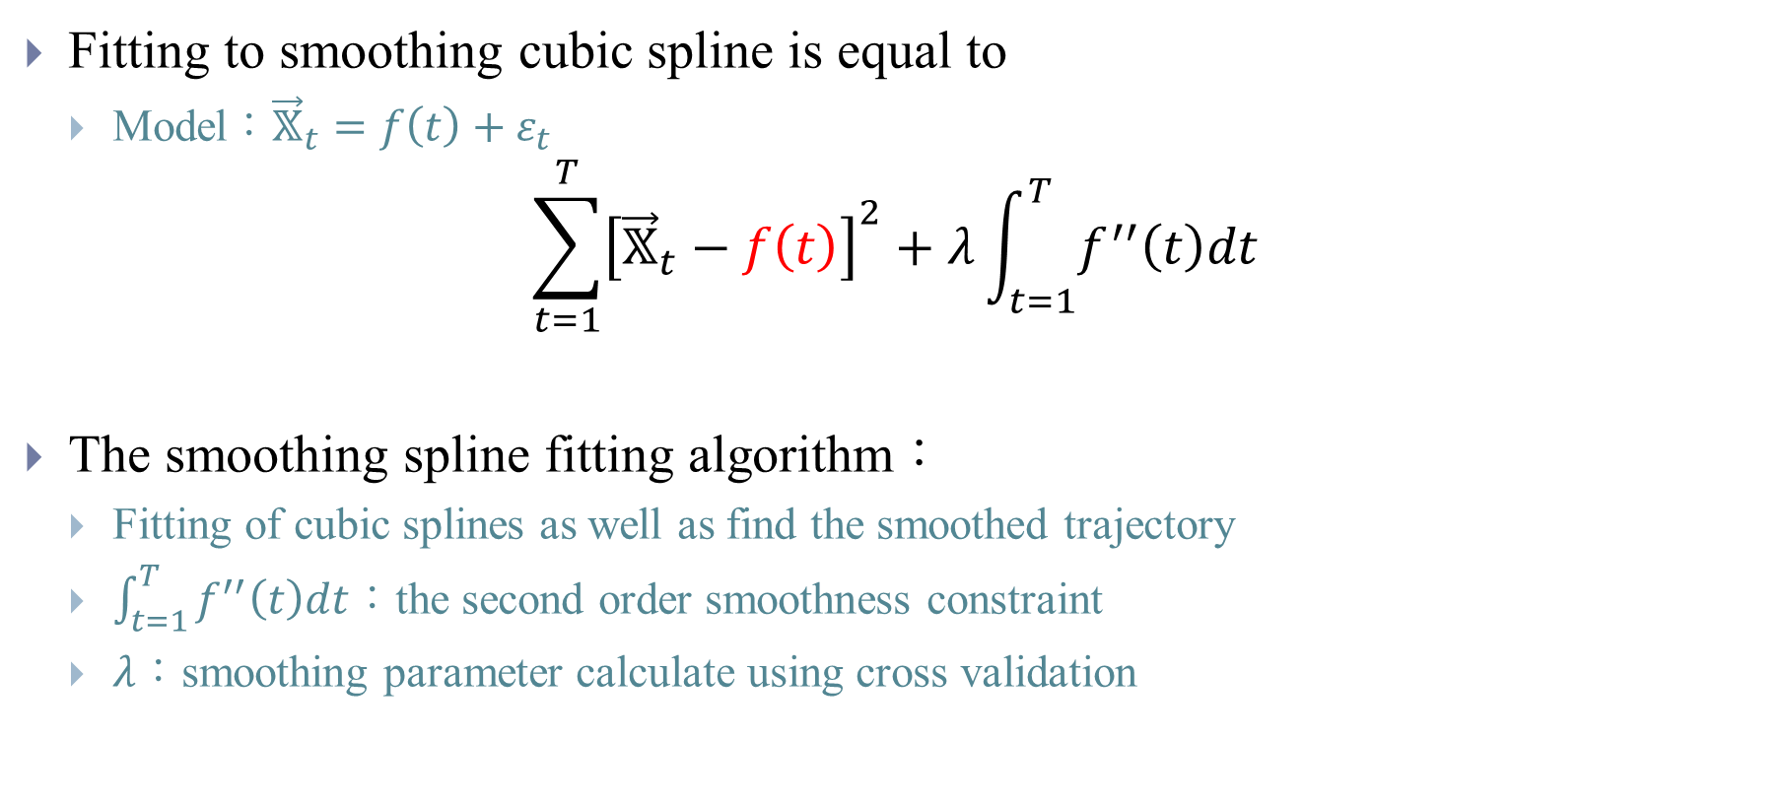
Unblur (2015)
Fitting to smoothing cubic spline is equal to
Model：${\vec{𝕏}}_{t}=f\left(t\right)+ε_{t}$
$$\sum_{t=1}^{T}{{\left[{\vec{𝕏}}_{t}−f\left(t\right)\right]}^{2}}+λ\int_{t=1}^{T}{f^{′′}\left(t\right)dt}$$
The smoothing spline fitting algorithm：
Fitting of cubic splines as well as find the smoothed trajectory
$\int_{t=1}^{T}{f^{′′}\left(t\right)dt}$：the second order smoothness constraint
$λ$：smoothing parameter calculate using cross validation
Notes:
Lambda -> 0 -> cubic spline
Lambda -> infinity ->straight line

Slide 7
MotionCorr2 (2017)
Align whole frames with Unblur-type approach
Divide image into grid of patches (e.g. 5⨉5)
Align each patch with Unblur-type approach
Fit shift at center of patches to a polynomial model
Use polynomial model to find pixel shifts between patch centers and deform image so that each pixel is appropriately shifted
Notes:
Quadratic in xy plane cubic in time
it was not possible to accurately determine local shifts by comparing noisy sub regions of each frame to one another as done within MotionCorr
Unfortunately, minimizing defocus, time or area significantly reduces the SNR available for measurement, ultimately leading to incorrect motion estimates.
For example, previous experiments with MotionCorr revealed that subdividing the images into areas smaller than ~2000 × ~2000 pixels or going to sub-frame integration times of less than 100 milliseconds worsened resolution due to increased errors in motion tracking.

Slide 8
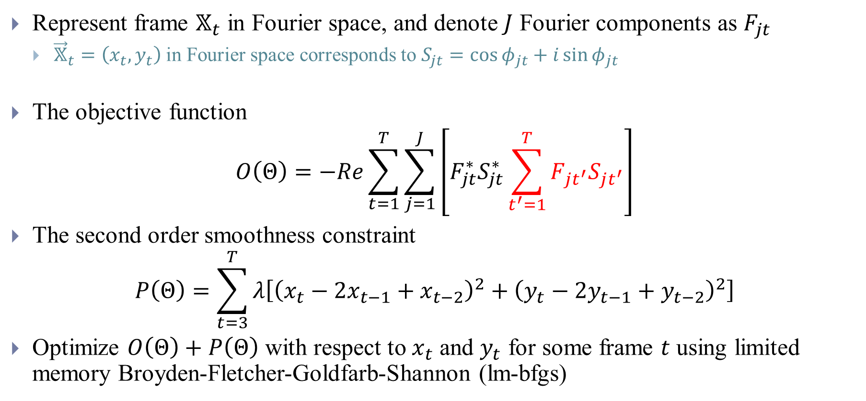
Alignframes_lmbfgs (2015)
Represent frame $𝕏_{t}$ in Fourier space, and denote $J$ Fourier components as $F_{jt}$
${\vec{𝕏}}_{t}=\left(x_{t},y_{t}\right)$ in Fourier space corresponds to $S_{jt}=\cos{φ_{jt}}+i\sin{φ_{jt}}$
The objective function
$$O\left(Θ\right)=−Re\sum_{t=1}^{T}{\sum_{j=1}^{J}{\left[F_{jt}^{∗}S_{jt}^{∗}\sum_{t^{′}=1}^{T}{F_{jt^{′}}S_{jt^{′}}}\right]}}$$
The second order smoothness constraint
$$P\left(Θ\right)=\sum_{t=3}^{T}{λ\left[{\left(x_{t}−2x_{t−1}+x_{t−2}\right)}^{2}+{\left(y_{t}−2y_{t−1}+y_{t−2}\right)}^{2}\right]}$$
Optimize $O\left(Θ\right)+P\left(Θ\right)$ with respect to $x_{t}$ and $y_{t}$ for some frame $t$ using limited memory Broyden-Fletcher-Goldfarb-Shannon (lm-bfgs)
Notes:
Not deviate from linear trajectory
$$φ_{jt}=𝓀_{x}\left(j\right)∙x_{t}\frac{2π}{N}+𝓀_{y}\left(j\right)∙y_{t}\frac{2π}{N}$$

Slide 9
Alignparts_lmbfgs (2015)
Divided frames into patches of overlapping regions/Particles
Additional constraint using local averaging
Notes:
Template matching to find 200 regions1
$$\begin{matrix}\frac{∂}{∂x_{t^{∗}}}O\left(Θ\right)+P\left(Θ\right) \\ \frac{∂}{∂y_{t^{∗}}}O\left(Θ\right)+P\left(Θ\right)\end{matrix}$$

Slide 10
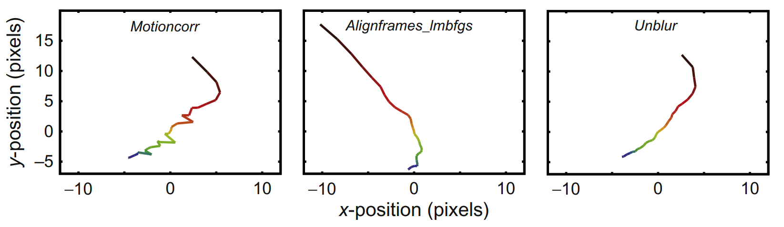
Comparison between three methods

Slide 11
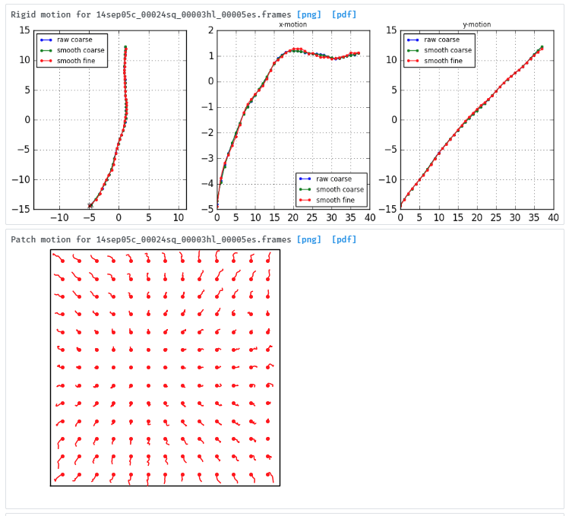
Variants of Alignparts
Based on Alignparts
CryoSparc
Local motion correction (Particle coordinate needed)
Patch motion correction
Warp
Local motion correction
Zorro/SubZorro
Use different measure of cross correlation

Slide 12
Particle Polishing (2014)
Assume map, viewing angle, defocus are all known
Bayesian polishing (2018)
Remove the linear constraints
Impose smoothness via prior

Slide 14
Publications
[1] Ripstein, Z. A., and J. L. Rubinstein. "Processing of cryo-EM movie data." Methods in enzymology. Vol. 579. Academic Press, 2016. 103-124.
[2] MotionCor: Li, Xueming, et al. "Electron counting and beam-induced motion correction enable near-atomic-resolution single-particle cryo-EM." Nature methods 10.6 (2013): 584.
[3] Unblur: Grant, Timothy, and Nikolaus Grigorieff. "Measuring the optimal exposure for single particle cryo-EM using a 2.6 Å reconstruction of rotavirus VP6." Elife 4 (2015): e06980.
[4] MotionCor2: Zheng, Shawn Q., et al. "MotionCor2: anisotropic correction of beam-induced motion for improved cryo-electron microscopy." Nature methods 14.4 (2017): 331.
[5] Alignparts_lmbfgs: Rubinstein, John L., and Marcus A. Brubaker. "Alignment of cryo-EM movies of individual particles by optimization of image translations." Journal of structural biology 192.2 (2015): 188-195.
[6] Warp: Tegunov, Dimitry, and Patrick Cramer. "Real-time cryo-EM data pre-processing with Warp." BioRxiv (2018): 338558.
[6] Particle polishing: Scheres, Sjors HW. "Beam-induced motion correction for sub-megadalton cryo-EM particles." Elife 3 (2014): e03665.
[7] Bayesian polishing: Zivanov, Jasenko, Takanori Nakane, and Sjors HW Scheres. "A Bayesian approach to beam-induced motion correction in cryo-EM single-particle analysis." IUCrJ 6.1 (2019).

Slide 15
Software
MotionCorr
MotionCor2
Unblur
Alignparts_lmbfgs
Warp
CryoSparc2

Slide 16
CTF Estimation

Slide 17
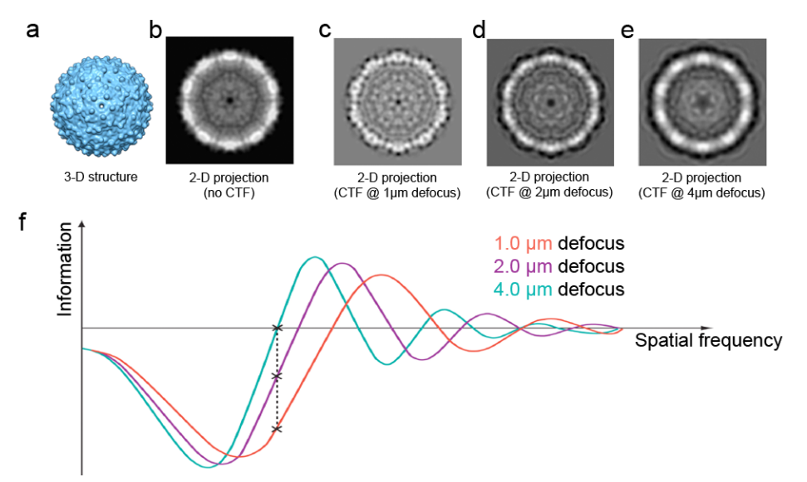
Review of CTF
If no astigmatism
Set DefocusU=DefocusV
Set Defocus angle = 0

Slide 18
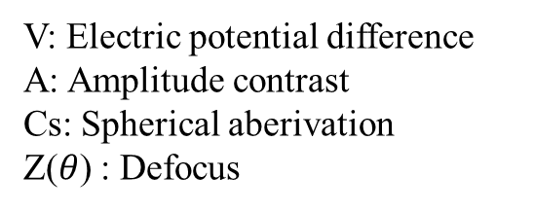
The related formula about CTF
V: Electric potential difference
A: Amplitude contrast
Cs: Spherical aberivation
Z($θ$) : Defocus
Notes:
amplitude contrast, A, is defined to be constrained between 0 and 1, but under most circumstances it is closer to 0. The CTFFIND online
documentation recommends values of 0.07 for vitreous ice samples and 0.15 for negatively-stained samples

Slide 19
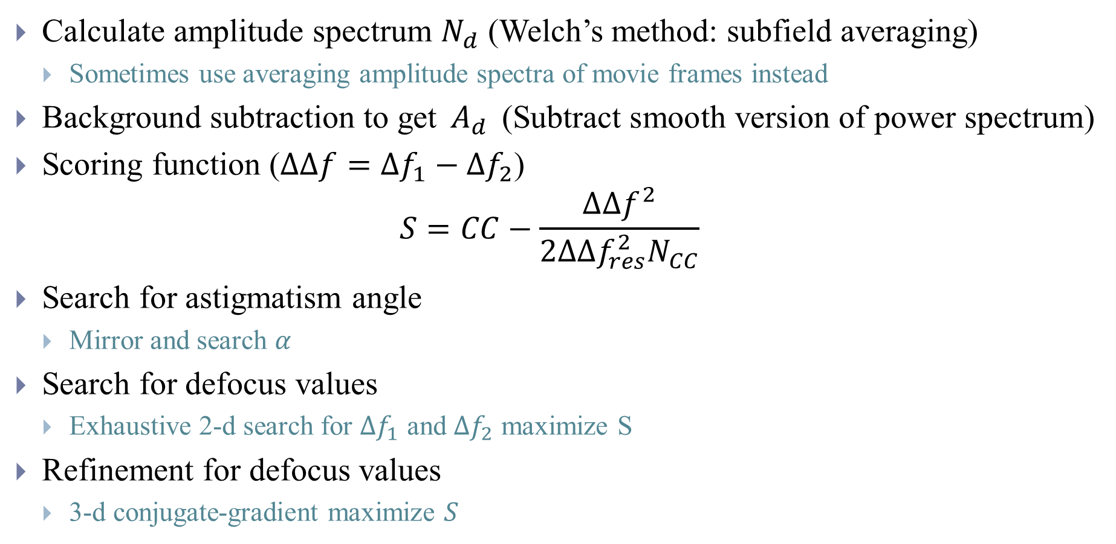
CTFFIND4 (2015)
Calculate amplitude spectrum $N_{d}$ (Welch’s method: subfield averaging)
Sometimes use averaging amplitude spectra of movie frames instead
Background subtraction to get $A_{d}$ (Subtract smooth version of power spectrum)
Scoring function ($∆∆f=∆f_{1}−∆f_{2}$)
$$S=CC−\frac{∆∆f^{2}}{2∆∆f_{res}^{2}N_{CC}}$$
Search for astigmatism angle
Mirror and search $α$
Search for defocus values
Exhaustive 2-d search for $∆f_{1}$ and $∆f_{2}$ maximize S
Refinement for defocus values
3-d conjugate-gradient maximize $S$
Notes:
Reduce noise
Estimate ramp
Phase plate

Slide 20
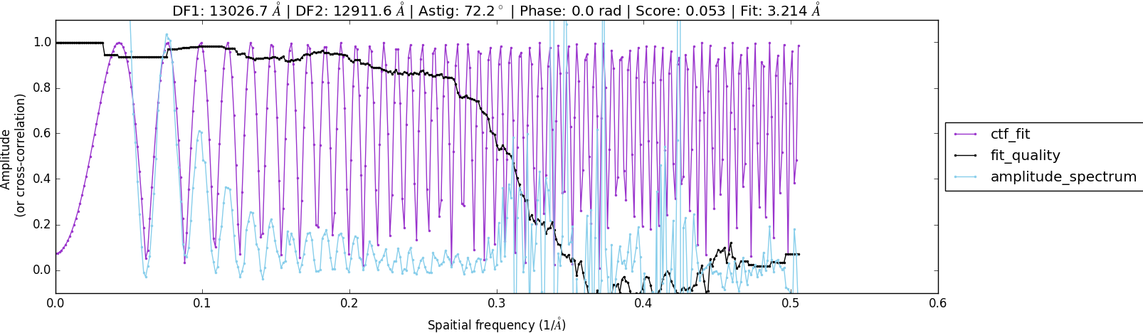
CTFFIND4 (2015)
Simulated
Notes:
Aliasing, noise cause
The minima of the oscillations are set to 0.0
Values are normalised such that the second peak of the power spectrum (in this case at around 0.06) is at 0.95
For spatial frequencies at which the power spectrum maxima are less than 0.1, values are normalised such that the values at estimated maxima positions are 0.1. This means that spatial frequencies at which no CTF rings were present in the power spectrum or at which the CTF estimation was wrong will end up with very noisy-looking 1D spectra.

Slide 21
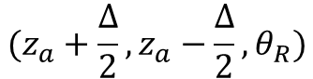
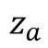
gCTF (2016)
$$z_{a}$$
$$(z_{a}+\frac{∆}{2},z_{a}−\frac{∆}{2},θ_{R})$$
Notes:
Use Logarithm instead of square root

Slide 22
gCTF (2016)
Use global CTF parameters as start
Calculate target amplitude spectrum of each particle

Slide 23
Local CTF
Based on patches
CryoSparc
Patch CTF estimation (Particle coordinate is not needed)
Warp (Local CTF estimation)
Divide into overlap patches
Subtract background globally
Fit CTF to each local 2D patches
goCTF
Notes:
Prefer orientation
Complex model
越來越接近particle itself
估tilt angle

Slide 24
Local CTF
Relion/CisTEM CTF Refinement
Notes:
同FORM

Slide 25
Publications
[1] Sheth, Lisa K., Angela L. Piotrowski, and Neil R. Voss. "Visualization and quality assessment of the contrast transfer function estimation." Journal of structural biology 192.2 (2015): 222-234.
[2] CTFFIND4: Rohou, Alexis, and Nikolaus Grigorieff. "CTFFIND4: Fast and accurate defocus estimation from electron micrographs." Journal of structural biology 192.2 (2015): 216-221.
[3] gCTF: Zhang, Kai. "Gctf: Real-time CTF determination and correction." Journal of structural biology 193.1 (2016): 1-12.
[4] goCTF: Su, Min. "goCTF: Geometrically optimized CTF determination for single-particle cryo-EM." Journal of structural biology 205.1 (2019): 22-29.
[5] CTF Refinement: Zivanov, Jasenko, et al. "New tools for automated high-resolution cryo-EM structure determination in RELION-3." Elife 7 (2018): e42166.

Slide 26
Software
CTFFIND4
gCTF
goCTF
Warp
CryoSparc2
Relion

Slide 27
Active Research Area
Local motion and CTF estimation
Accurate particle picking
3D variability

Slide 28
Appendix

Slide 29
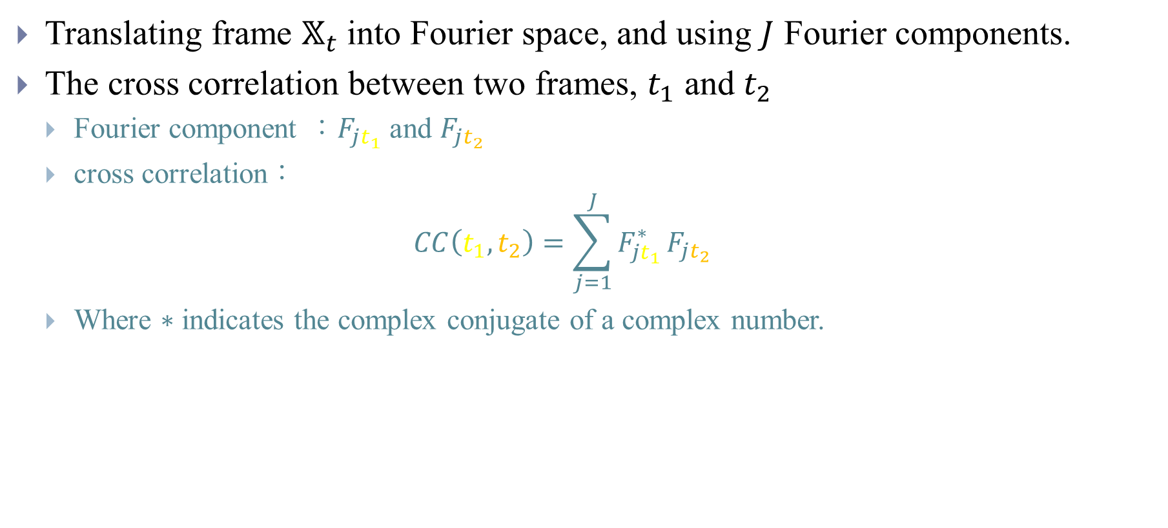
Cross correlation in Fourier space
Translating frame $𝕏_{t}$ into Fourier space, and using $J$ Fourier components.
The cross correlation between two frames, $t_{1}$ and $t_{2}$
Fourier component ：$F_{jt_{1}}$ and $F_{jt_{2}}$
cross correlation：
$$CC\left(t_{1},t_{2}\right)=\sum_{j=1}^{J}{F_{{jt}_{1}}^{∗}}F_{jt_{2}}$$
Where $∗$ indicates the complex conjugate of a complex number.

Slide 30
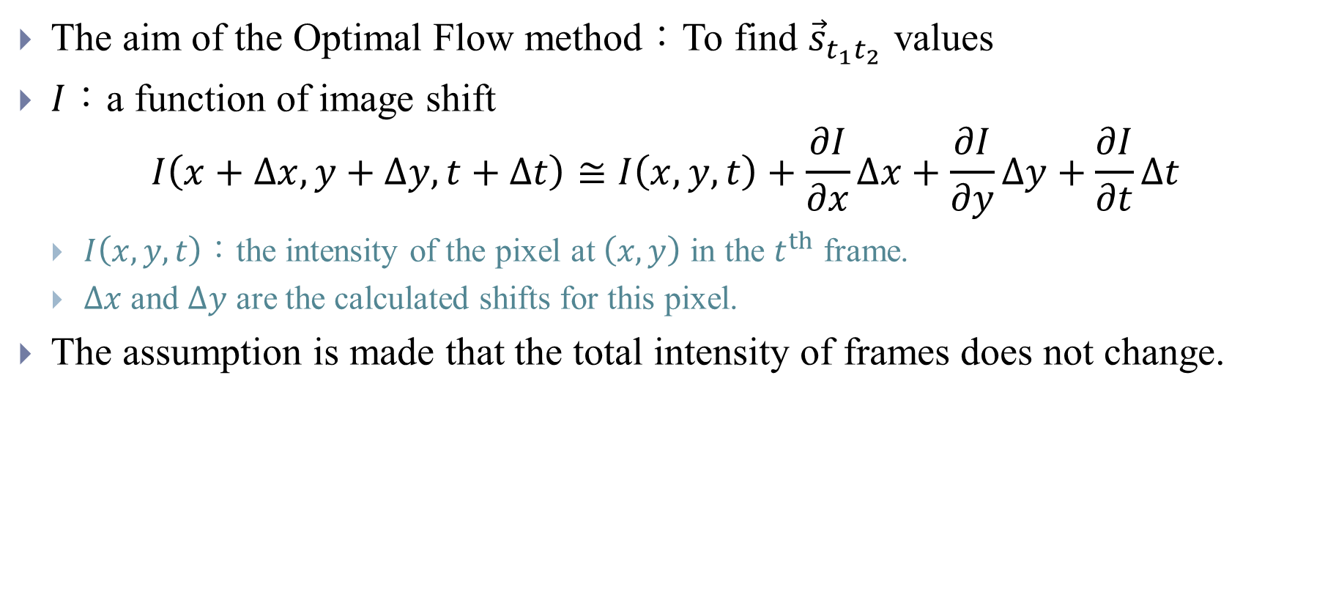
Optical flow
The aim of the Optimal Flow method：To find ${\vec{s}}_{t_{1}t_{2}}$ values
$I$：a function of image shift
$$I\left(x+∆x,y+∆y,t+∆t\right)≅I\left(x,y,t\right)+\frac{∂I}{∂x}∆x+\frac{∂I}{∂y}∆y+\frac{∂I}{∂t}∆t$$
$I\left(x,y,t\right)$：the intensity of the pixel at $\left(x,y\right)$ in the $t^{th}$ frame.
$∆x$ and $∆y$ are the calculated shifts for this pixel.
The assumption is made that the total intensity of frames does not change.

Slide 31
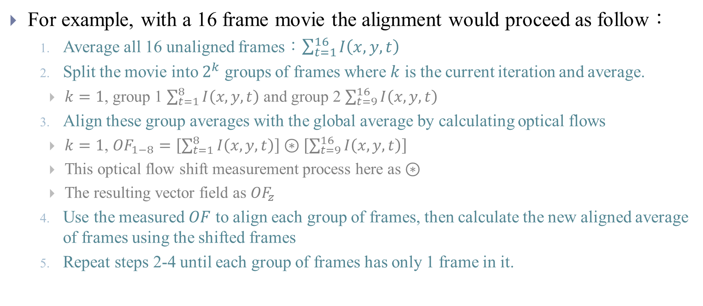
Optical flow
For example, with a 16 frame movie the alignment would proceed as follow：
Average all 16 unaligned frames：$\sum_{t=1}^{16}{I\left(x,y,t\right)}$
Split the movie into $2^{k}$ groups of frames where $k$ is the current iteration and average.
$k=1$, group 1 $\sum_{t=1}^{8}{I\left(x,y,t\right)}$ and group 2 $\sum_{t=9}^{16}{I\left(x,y,t\right)}$
Align these group averages with the global average by calculating optical flows
$k=1$, ${OF}_{1−8}=\left[\sum_{t=1}^{8}{I\left(x,y,t\right)}\right]⊛\left[\sum_{t=9}^{16}{I\left(x,y,t\right)}\right]$
This optical flow shift measurement process here as $⊛$
The resulting vector field as ${OF}_{z}$
Use the measured $OF$ to align each group of frames, then calculate the new aligned average of frames using the shifted frames
Repeat steps 2-4 until each group of frames has only 1 frame in it.

Slide 32
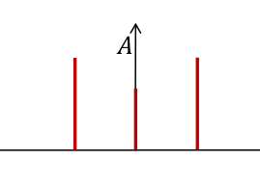
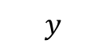
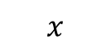
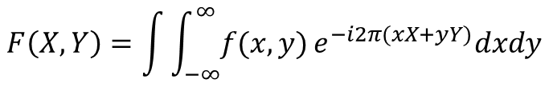
Introduction
2D Fourier transform
$$y$$
Intensity vs frequency
Result is complex number
2D Shift
$$x$$
$$F\left(X,Y\right)=\int{\int_{−∞}^{∞}{f(x,y)}e^{−i2π(xX+yY)}dxdy}$$
Notes:
1. Symmetric around original points!
2. Reference also see https://www.youtube.com/watch?v=nyk75ufbP74&t=0s&index=18&list=PL8_xPU5epJdctoHdQjpfHmd_z9WvGxK8-

